Slide 1
IMAGE PROCESSING USING PYTHON
for
III B.Tech (CSM & AIML) - I Semester
By
T. Vijaya Kumar
Assistant Professor
Dept. of ECE, VVIT

Slide 2
UNIT – II
IMAGE ENHANCEMENT

Slide 3
SYLLABUS
UNIT – II Image Enhancement
Spatial domain methods:
Point & Histogram processing
Fundamentals of Spatial filtering
Smoothing spatial filters
Sharpening spatial filters
Frequency domain methods:
Basics of filtering in frequency domain
Image smoothing
Image sharpening
Selective filtering
Text Books:
Digital Image Processing – Gonzaleze and Woods, 2nd Ed., Pearson.
S. Jayaraman, S. Esakkirajan and T. VeeraKumar, “Digital Image processing, Tata McGraw Hill publishers, 2009

Slide 4
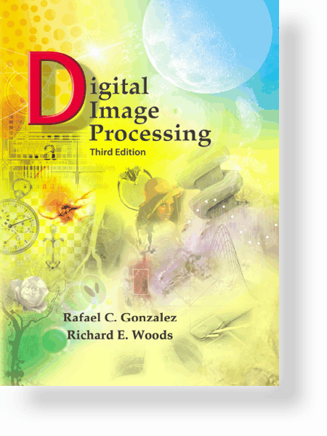
UNIT – II: Image Enhancement in the Spatial Domain
Spatial domain methods
Point Processing
Histogram processing
Fundamentals of Spatial filtering
Smoothing Spatial filters
Sharpening spatial filters
Combining spatial enhancement methods

Slide 5
UNIT – II: Image Enhancement in the Spatial Domain
Introduction
Spatial domain
Image plane itself, directly process the intensity values of the image plane.
Transform domain
process the transform coefficients, not directly process the intensity values of the image plane.

Slide 6
UNIT – II: Image Enhancement in the Spatial Domain
Contd…

Slide 7
UNIT – II: Image Enhancement in the Spatial Domain
Contd…
A 3*3 neighborhood about
a point (x, y) in an image

Slide 8
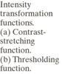
UNIT – II: Image Enhancement in the Spatial Domain
Contd…

Slide 9
UNIT – II: Image Enhancement in the Spatial Domain
Point Processing
Image Negatives
Log Transformations
Power-Law Transformations
Piecewise-Linear Transformation Functions
Thresholding
Contrast Stretching
Intensity-level slicing
Gray-level slicing
Bit-plane slicing

Slide 10
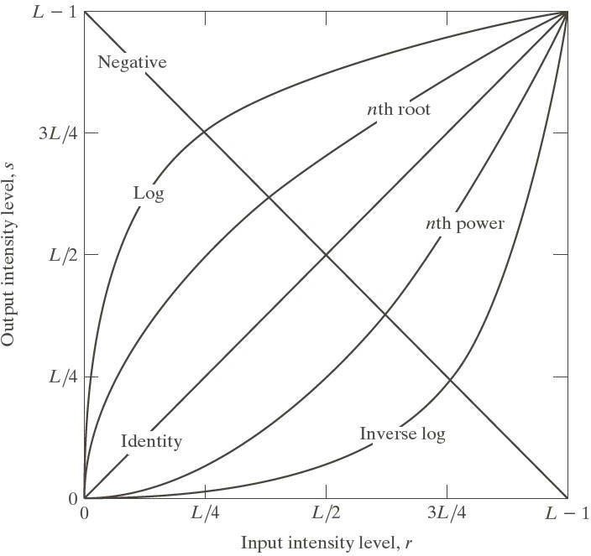
UNIT – II: Image Enhancement in the Spatial Domain
Contd…
Fig. Some basic gray-level transformation functions used for image enhancement

Slide 11
UNIT – II: Image Enhancement in the Spatial Domain
Image Negatives

Slide 12
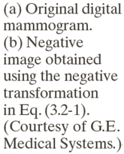
UNIT – II: Image Enhancement in the Spatial Domain
Example: Image Negatives
Small lesion

Slide 13
UNIT – II: Image Enhancement in the Spatial Domain
Log Transformations

Slide 14
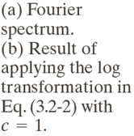
UNIT – II: Image Enhancement in the Spatial Domain
Example: Log Transformations

Slide 15
UNIT – II: Image Enhancement in the Spatial Domain
Power-Law Transformations
Plots of the equation
s = c r^{γ} for various
values of γ (c=1 in all cases)

Slide 16
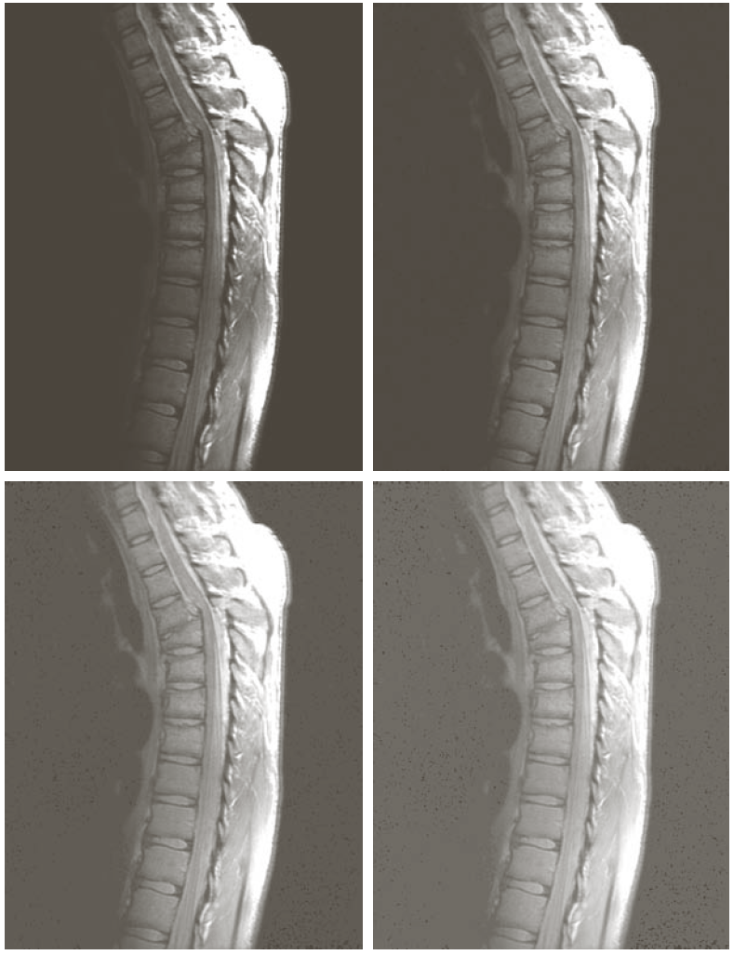
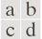
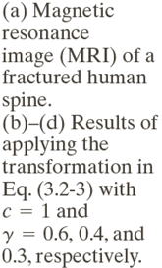
UNIT – II: Image Enhancement in the Spatial Domain
Example: Gamma Transformations

Slide 17
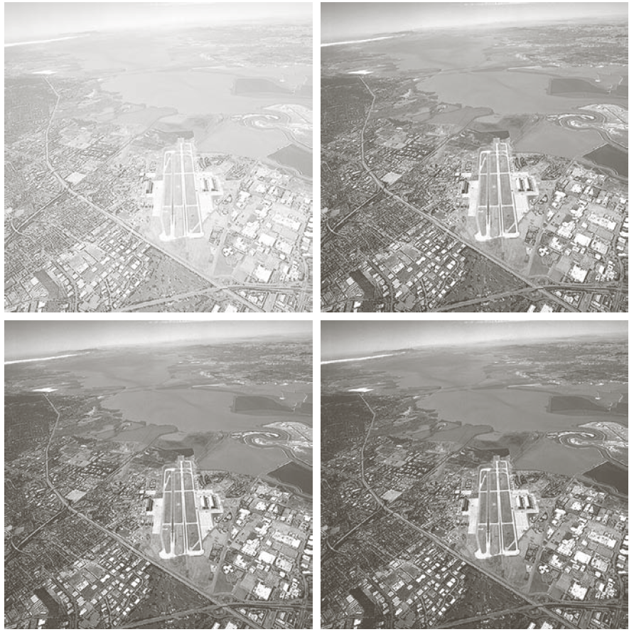

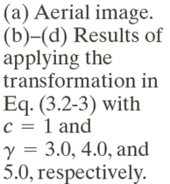
UNIT – II: Image Enhancement in the Spatial Domain
Example: Gamma Transformations

Slide 18
UNIT – II: Image Enhancement in the Spatial Domain
Piecewise-Linear Transformations
Contrast Stretching
— Expands the range of intensity levels in an image so that it spans the full intensity range of the recording medium or display device.
Intensity-level Slicing
— Highlighting a specific range of intensities in an image often is of interest.

Slide 19
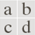
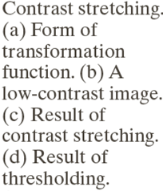
UNIT – II: Image Enhancement in the Spatial Domain
Contrast Stretching

Slide 20
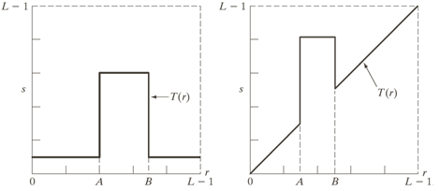
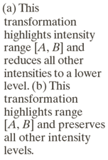
UNIT – II: Image Enhancement in the Spatial Domain
Gray-level slicing

Slide 21
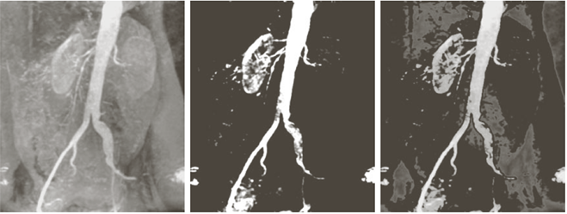
UNIT – II: Image Enhancement in the Spatial Domain
Example: Gray-level slicing

Slide 22
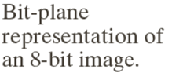
UNIT – II: Image Enhancement in the Spatial Domain
Bit-plane Slicing

Slide 23
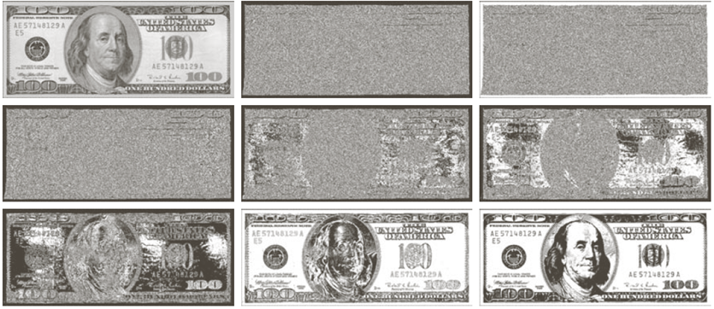
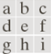
UNIT – II: Image Enhancement in the Spatial Domain
Example: Bit-plane slicing

Slide 24

UNIT – II: Image Enhancement in the Spatial Domain
Contd…

Slide 25
UNIT – II: Image Enhancement in the Spatial Domain
Example: Bit-plane slicing
An 8-bit fractal image

Slide 26
UNIT – II: Image Enhancement in the Spatial Domain
Contd…

Slide 27
UNIT – II: Image Enhancement in the Spatial Domain
Histogram Processing
Histogram Equalization
Histogram Matching
Local Histogram Processing

Slide 28
UNIT – II: Image Enhancement in the Spatial Domain
Introduction

Slide 29


Slide 30
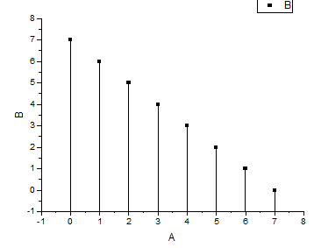
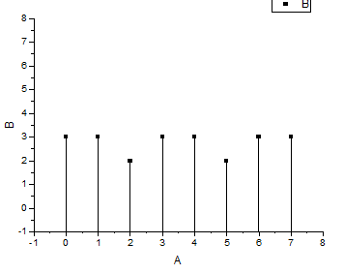

Slide 31
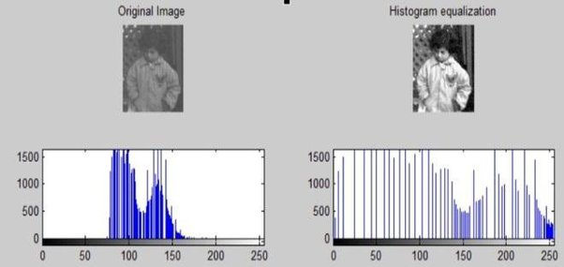

Slide 32
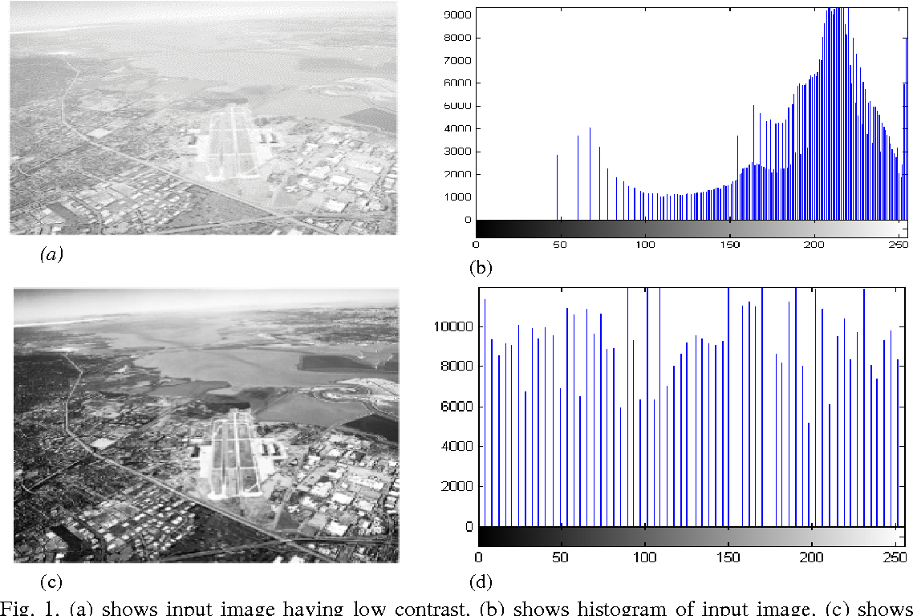

Slide 33
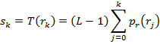
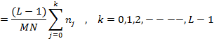
UNIT – II: Image Enhancement in the Spatial Domain
Histogram Equalization
It is a process that attempts to spread out the gray levels in an image so that they are evenly distributed across their image
Procedure to perform Histogram Equalization
Find the running sum of the histogram values.
Normalize the values from step (1) by dividing by the total number of pixels.
Multiply the values from step (2) by the maximum gray level value and round.
Map the gray level values to the results from step (3) using a one-to-one correspondence.

Slide 34
UNIT – II: Image Enhancement in the Spatial Domain
Example: Histogram Equalization
Q. Suppose that a 3-bit image (L=8) of size 5 × 5 pixels has the intensity distribution shown in following table. Perform histogram equalization of the image ?
r_{k} | n_{k}
0 | 0
1 | 0
2 | 0
3 | 6
4 | 14
5 | 5
6 | 0
7 | 0
4 4 4 4 4
3 4 5 4 3
3 5 5 5 3
3 4 5 4 3
4 4 4 4 4

Slide 35
Example: Histogram Equalization
Gray level | 0 | 1 | 2 | 3 | 4 | 5 | 6 | 7
Number of pixels | 0 | 0 | 0 | 6 | 14 | 5 | 0 | 0
Running sum | 0 | 0 | 0 | 6 | 20 | 25 | 25 | 25
Running sum / Total number of pixels | 0/25 | 0/25 | 0/25 | 6/25 | 20/25 | 25/25 | 25/25 | 25/25
Multiply the above result by maximum gray level | (0/25)*7 = 0 | (0/25) *7 = 0 | (0/25) *7 = 0 | (6/25) *7 = 2 | (20/25) *7 = 6 | (25/25) *7 = 7 | (25/25) *7 = 7 | (25/25) *7 = 7

Slide 36
UNIT – II: Image Enhancement in the Spatial Domain
Example: Histogram Equalization
Mapping of gray level by a one-to-one correspondence
Original gray level | Histogram equalized values
0 | 0
1 | 0
2 | 0
3 | 2
4 | 6
5 | 7
6 | 7
7 | 7

Slide 37
UNIT – II: Image Enhancement in the Spatial Domain
Example: Histogram Equalization
4 4 4 4 4
3 4 5 4 3
3 5 5 5 3
3 4 5 4 3
4 4 4 4 4
6 6 6 6 6
2 6 7 6 2
2 7 7 7 2
2 6 7 6 2
6 6 6 6 6
Histogram
Equalization

Slide 38
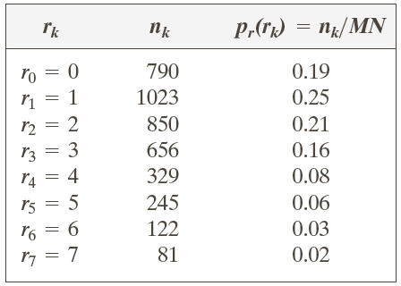
UNIT – II: Image Enhancement in the Spatial Domain
Example: Histogram Equalization
Q. Suppose that a 3-bit image (L=8) of size 64 × 64 pixels (MN = 4096) has the intensity distribution shown in following table. Get the histogram equalization transformation function and give the p_{s}(s_{k}) for each s_{k}.

Slide 39
Example: Histogram Equalization

Slide 40
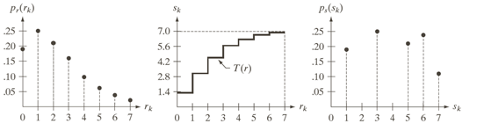
UNIT – II: Image Enhancement in the Spatial Domain
Example: Histogram Equalization

Slide 41
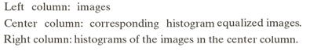

Slide 42
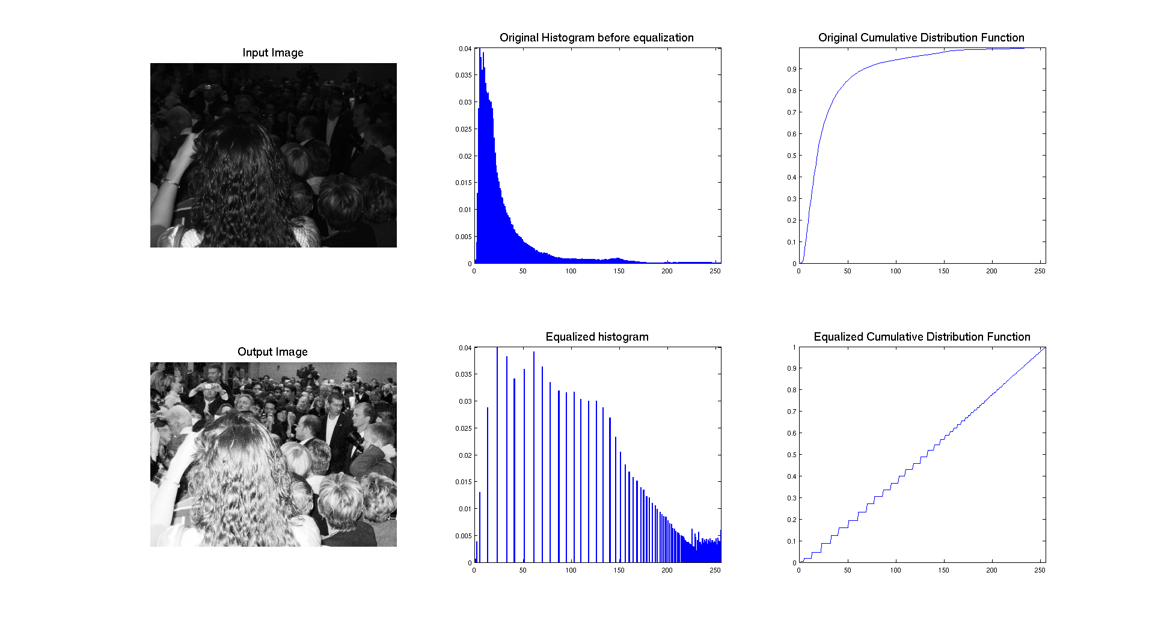
Example: Histogram Equalization

Slide 43
UNIT – II: Image Enhancement in the Spatial Domain
Histogram Matching (Specification)
— generate a processed image that has a specified histogram
Development of the method
Determine the transformation ( s_{k} ) = T ( r_{k )} that can equalize the original image's histogram p_{r}(r).
2. Determine the transformation (s_{k} ) = G ( b_{k} ) that can equalize the desired image's histogram p_{b}(b).
3. Perform transformation G⁻¹(T(r_{k} )) .

Slide 44
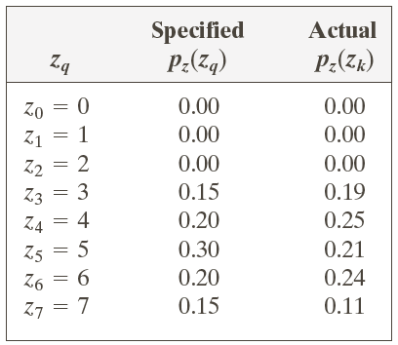
UNIT – II: Image Enhancement in the Spatial Domain
Example: Histogram Matching
Q. Suppose that a 3-bit image (L=8) of size 64 × 64 pixels (MN = 4096) has the intensity distribution shown in the following table (on the left). Get the histogram transformation function and make the output image with the specified histogram, listed in the table on the right.

Slide 45
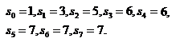
Obtain the scaled histogram-equalized values,
Compute all the values of the transformation function G,

Slide 46
Obtain the scaled histogram-equalized values,
Compute all the values of the transformation function G,
s₀
s₁
s₂
s₃
s₄
s₅
s₆
s₇

Slide 48
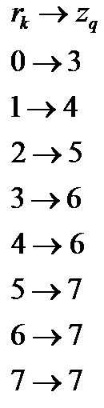

Slide 49
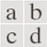
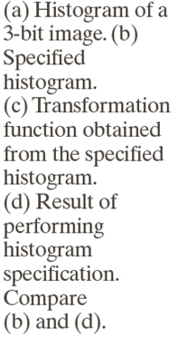

Slide 50
UNIT – II: Image Enhancement in the Spatial Domain
Local Histogram Processing
- Define a neighborhood and move its center from pixel to pixel
- At each location, the histogram of the points in the neighborhood is computed. Either histogram equalization or histogram specification transformation function is obtained
- Map the intensity of the pixel centered in the neighborhood
- Move to the next location and repeat the procedure

Slide 51

UNIT – II: Image Enhancement in the Spatial Domain
Example: Local Histogram Processing

Slide 52
UNIT – II: Image Enhancement in the Spatial Domain
Fundamentals of Spatial Filtering
- A spatial filter consists of (a) a neighborhood, and (b) a predefined operation
- Linear spatial filtering of an image of size MxN with a filter of size mxn is
given by the expression

Slide 53
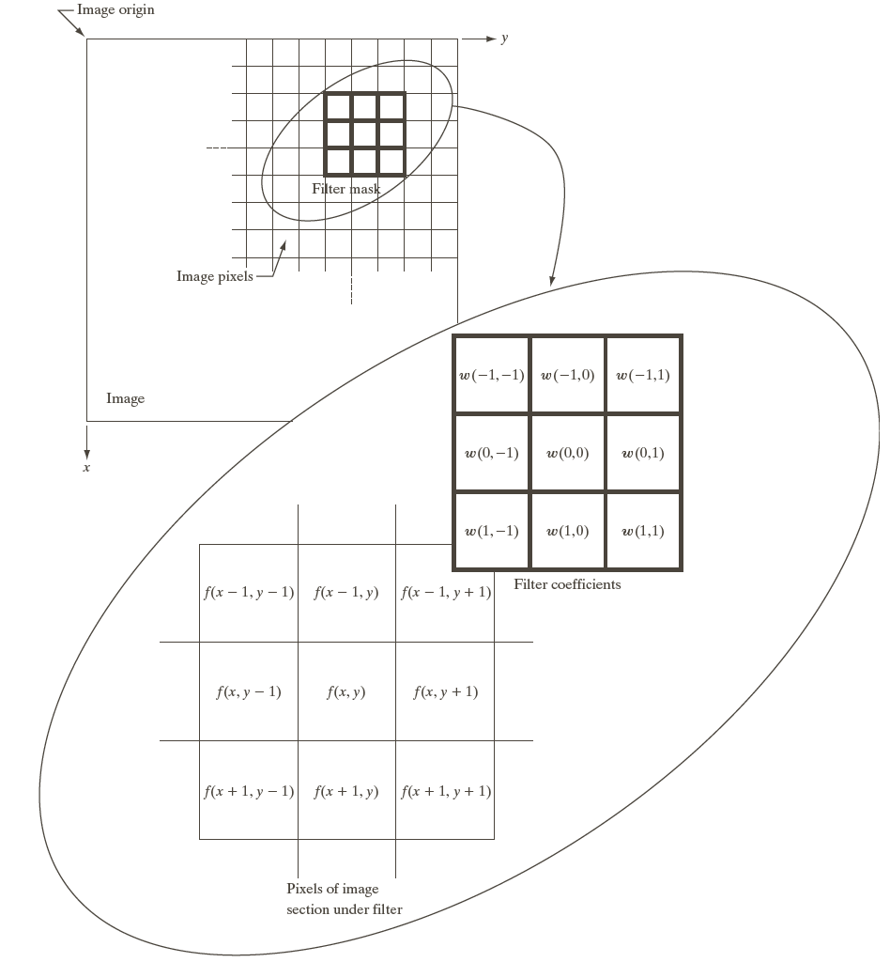
UNIT – II: Image Enhancement in the Spatial Domain
Contd…

Slide 54
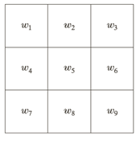
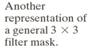
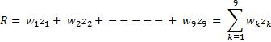
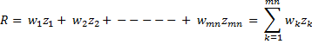
UNIT – II: Image Enhancement in the Spatial Domain
Contd…

Slide 55
UNIT – II: Image Enhancement in the Spatial Domain
Smoothing Spatial Filters
- Smoothing filters are used for blurring and for noise reduction
- Blurring is used in removal of small details and bridging of small gaps in lines or curves
- Smoothing spatial filters include
Linear filters
Averaging Filter
Nonlinear filters
Median Filter
Maximum Filter
Minimum Filter

Slide 56
UNIT – II: Image Enhancement in the Spatial Domain
Spatial Smoothing Linear Filters

Slide 57
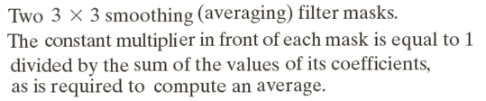
UNIT – II: Image Enhancement in the Spatial Domain
Smoothing Averaging Filter Masks

Slide 58
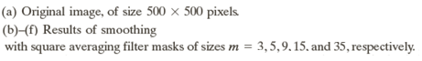
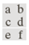
UNIT – II: Image Enhancement in the Spatial Domain
Example: Smoothing Averaging Filter Masks

Slide 59
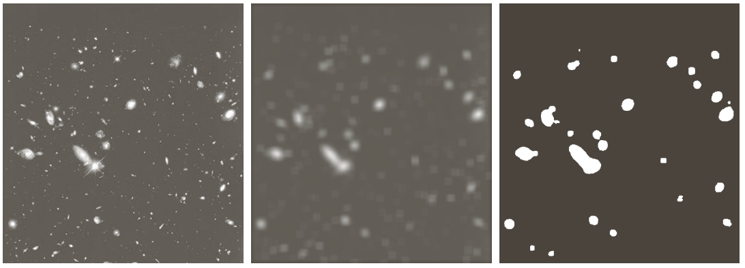
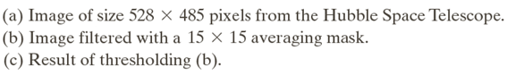
UNIT – II: Image Enhancement in the Spatial Domain
Example: Smoothing Averaging Filter Masks

Slide 60
UNIT – II: Image Enhancement in the Spatial Domain
Order-statistic (Nonlinear) Filters
— Nonlinear
— Based on ordering (ranking) the pixels contained in the filter mask
— Replacing the value of the center pixel with the value determined by the ranking
result
E.g., Median filter
Max filter
Min filter

Slide 61
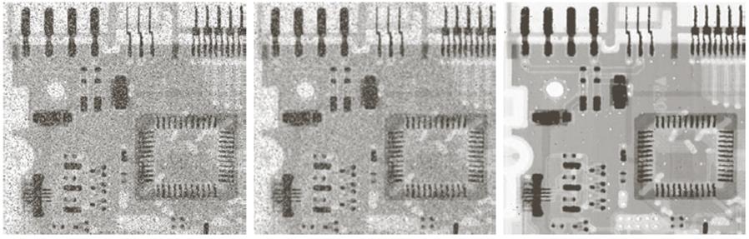
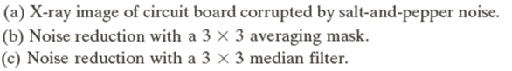
UNIT – II: Image Enhancement in the Spatial Domain
Example: Use of Median Filtering for Noise Reduction

Slide 62
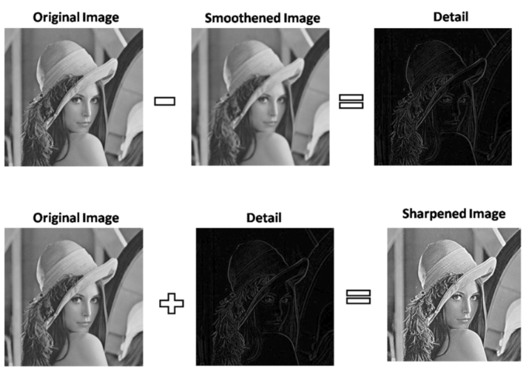
UNIT – II: Image Enhancement in the Spatial Domain
Sharpening Spatial Filters

Slide 63
UNIT – II: Image Enhancement in the Spatial Domain
Sharpening Spatial Filters
Foundation
Laplacian Operator
Unsharp Masking and High boost Filtering
Using First-Order Derivatives for Nonlinear Image Sharpening — The Gradient

Slide 64
UNIT – II: Image Enhancement in the Spatial Domain
Foundation of sharpening filters
The first-order derivative of a one-dimensional function f(x) is the difference
The second-order derivative of f(x) as the difference

Slide 65
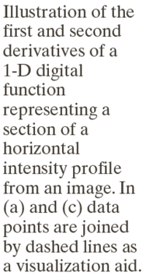
UNIT – II: Image Enhancement in the Spatial Domain
Contd…

Slide 66
UNIT – II: Image Enhancement in the Spatial Domain
Laplacian Operator
- The second-order isotropic derivative operator is the Laplacian for a function (image) f(x,y)

Slide 67
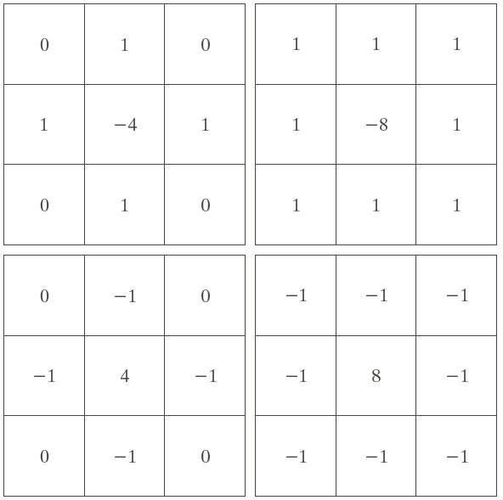

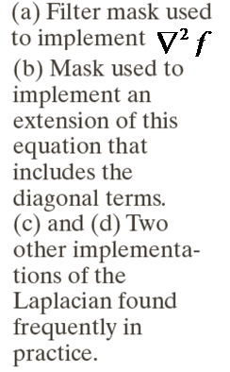
UNIT – II: Image Enhancement in the Spatial Domain
Contd…

Slide 68
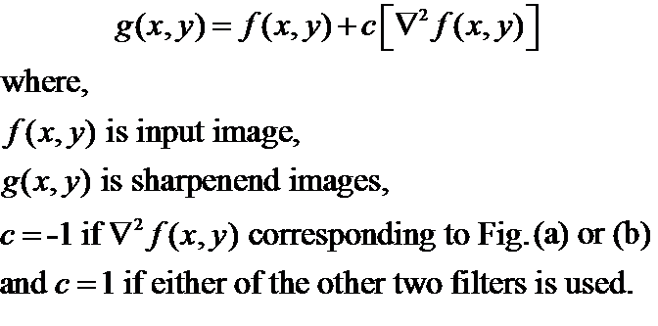
UNIT – II: Image Enhancement in the Spatial Domain
Contd…
Image sharpening in the way of using the Laplacian

Slide 69



UNIT – II: Image Enhancement in the Spatial Domain
Example: Laplacian Operator

Slide 70
UNIT – II: Image Enhancement in the Spatial Domain
Unsharp Masking & High boost Filtering
Unsharp masking
- Sharpen images consists of subtracting an unsharp (smoothed) version of an
image from the original image
e.g., printing and publishing industry
Steps
1. Blur the original image
2. Subtract the blurred image from the original
3. Add the mask to the original

Slide 71
UNIT – II: Image Enhancement in the Spatial Domain
Unsharp Masking & High boost Filtering

Slide 72


UNIT – II: Image Enhancement in the Spatial Domain
Example: Unsharp Masking and High boost Filtering

Slide 73
UNIT – II: Image Enhancement in the Spatial Domain
Gradient (First-Order Derivatives)
Gradient Image

Slide 74
UNIT – II: Image Enhancement in the Spatial Domain
Contd…
z₁ | z₂ | z₃
z₄ | z₅ | z₆
z₇ | z₈ | z₉

Slide 75
UNIT – II: Image Enhancement in the Spatial Domain
Contd…
z₁ | z₂ | z₃
z₄ | z₅ | z₆
z₇ | z₈ | z₉

Slide 76



UNIT – II: Image Enhancement in the Spatial Domain
Contd…

Slide 77

UNIT – II: Image Enhancement in the Spatial Domain

Slide 78

UNIT – II: Image Enhancement in the Spatial Domain
Example: Sobel Operator

Slide 79


UNIT – II: Image Enhancement in the Spatial Domain
Example: Sobel Operator

